Slide 1


Walmart Sales Data Analysis
This presentation provides a comprehensive analysis of Walmart's sales data, exploring trends, customer behavior, and geographical performance.
by Kunal Dagar
Video Link : https://drive.google.com/file/d/1iyyl3KzoQiiK1ZBbic7ArMROm3F_WoTO/view?usp=sharing

Slide 2


Introduction and Problem Statement Overview
Introduction
Problem Statement
This project utilizes advanced MySQL techniques to analyze Walmart's transaction data, exploring sales performance, customer behavior, and product trends. The goal is to uncover actionable insights to optimize sales strategies and enhance operational efficiency.
Walmart aims to optimize sales strategies by analyzing historical transaction data across branches, customer types, payment methods, and product lines. Advanced MySQL queries will address key challenges in sales performance, customer segmentation, and product trends.

Slide 3
Task 1
Identifying the Top Branch by Sales Growth Rate
Walmart wants to identify which branch has exhibited the highest sales growth over time.
Analyze the total sales for each branch and compare the growth rate across months to find
the top performer .

Slide 4
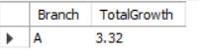
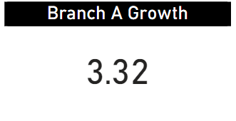
SQL Query
WITH MonthlySales AS
( SELECT Branch, MONTH(Date) AS Month, ROUND(SUM(Total),2) AS TotalSales
FROM walmartsales
GROUP BY Branch, MONTH(Date) ),
GrowthRate AS
(SELECT Branch, Month, TotalSales,
LAG(TotalSales) OVER (PARTITION BY Branch ORDER BY Month) AS PreviousSales, #Growth rate
ROUND((TotalSales - LAG(TotalSales) OVER (PARTITION BY Branch ORDER BY Month)) / LAG(TotalSales) OVER (PARTITION BY Branch ORDER BY Month) * 100,2) AS Growth
FROM MonthlySales ),
NetGrowth AS (SELECT Branch, ROUND(SUM(Growth),2) AS TotalGrowth
FROM GrowthRate
WHERE Growth IS NOT NULL
GROUP BY Branch )
SELECT Branch, TotalGrowth
FROM NetGrowth
ORDER BY TotalGrowth DESC
LIMIT 1;

Slide 5
Task 2
Finding the Most Profitable Product Line for Each Branch
Walmart needs to determine which product line contributes the highest profit to each branch.
The profit margin should be calculated based on the difference between the gross income and
cost of goods sold

Slide 6
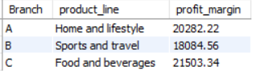
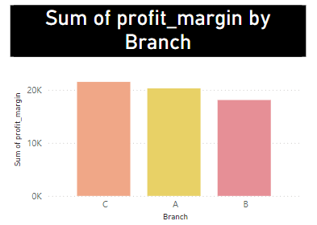
SQL Query
USE final_project;
SELECT * FROM walmartsales;
WITH profit_margin AS
(SELECT Branch, `Product line` AS product_line,
ROUND(SUM(cogs - `gross income`),2) AS profit_margin
FROM walmartsales
GROUP BY product_line, Branch
ORDER BY profit_margin)
SELECT Branch, product_line, profit_margin
FROM
(SELECT Branch, product_line, profit_margin ,
RANK() OVER(PARTITION BY Branch ORDER BY profit_margin DESC) AS RANKS
FROM profit_margin) rankedprofit
WHERE RANKS = 1ORDER BY Branch;

Slide 7
Task 3
Analyzing Customer Segments Based on Spendings
Walmart wants to segment customers based on their average spending behavior. Classify
customers into three tiers: High, Medium, and Low spenders based on their total purchase
amounts.

Slide 8
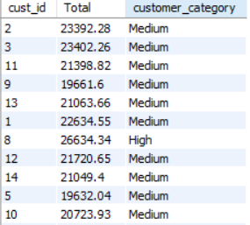
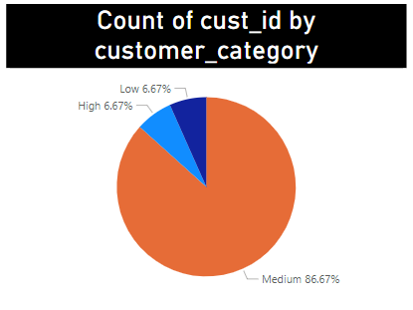
SQL Query
WITH cust_group_by AS
(SELECT `Customer ID` AS cust_id, ROUND(SUM(Total),2) AS Total
FROM Walmartsales
GROUP BY cust_id),
avgTotal AS
(SELECT AVG(Total) AS average,
ROUND(AVG(Total) - AVG(Total)*0.1,2) AS lowerlimit,
ROUND(AVG(Total) + AVG(Total)*0.1,2) AS upperlimit
FROM cust_group_by)
SELECT cust_id, Total,
CASE
WHEN total>upperlimit THEN 'High'
WHEN total<lowerlimit THEN 'Low'
ELSE 'Medium’
END AS customer_category
FROM cust_group_by, avgTotal

Slide 9
Task 4
Detecting Anomalies in Sales Transactions
Walmart suspects that some transactions have unusually high or low sales compared to the
average for the product line. Identify these anomalies

Slide 10
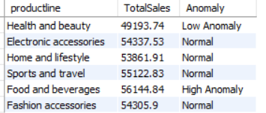
SQL Query
WITH productline_wise_sales AS
(SELECT `Product line` AS productline, ROUND(SUM(Total), 2) AS TotalSales
FROM walmartsales
GROUP BY productline),
average_sales AS
( SELECT AVG(TotalSales) AS avg_sales
FROM productline_wise_sales),
avg_deviation AS
(SELECT p.productline, p.TotalSales,
CASE
WHEN p.TotalSales < a.avg_sales * 0.99 THEN 'Low Anomaly'
WHEN p.TotalSales > a.avg_sales * 1.03 THEN 'High Anomaly’
ELSE 'Normal’
END AS Anomaly
FROM productline_wise_sales p, average_sales a)
SELECT productline, TotalSales, Anomaly
FROM avg_deviation;

Slide 11
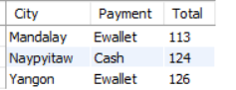
Task 5
Most Popular Payment Method by City
Walmart needs to determine the most popular payment method in each city to tailor
marketing strategies.
SQL Query
WITH PaymentCounts AS
(SELECT City, Payment, COUNT(*) AS Total
FROM walmartsales
GROUP BY City, Payment),
RankedPayments AS
(SELECT City, Payment, Total,
RANK() OVER (PARTITION BY City ORDER BY Total DESC) AS Ranks
FROM PaymentCounts)SELECT City, Payment, Total
FROM RankedPayments
WHERE Ranks = 1
ORDER BY City;

Slide 12
Task 6
Monthly Sales Distribution by Gender
Walmart wants to understand the sales distribution between male and female customers on a
monthly basis.

Slide 13
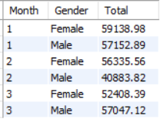
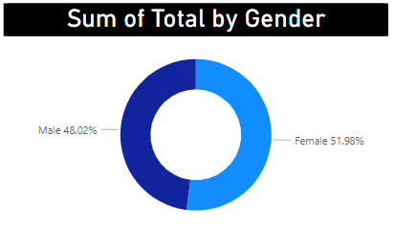
SQL Query
WITH monthly_analysis AS
(SELECT MONTH(Date) AS Month, ROUND(SUM(Total), 2) AS Totalsales
FROM walmartsales
GROUP BY MONTH(Date)),
genderbase AS
(SELECT MONTH(ws.Date) AS Month, ws.Gender,
ROUND(SUM(ws.Total), 2) AS Totalsales,
DENSE_RANK() OVER (PARTITION BY MONTH(ws.Date), ws.Gender
ORDER BY SUM(ws.Total) DESC) AS ranks
FROM walmartsales ws
GROUP BY MONTH(ws.Date), ws.Gender)
SELECT ma.Month, gb.Gender, SUM(gb.Totalsales) AS Total
FROM monthly_analysis ma
JOIN genderbase gb ON ma.Month = gb.Month
WHERE gb.ranks = 1
GROUP BY ma.Month, gb.Gender
ORDER BY ma.Month;

Slide 14
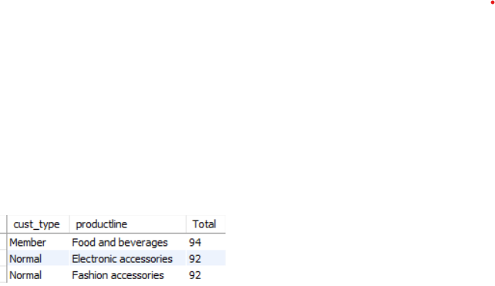
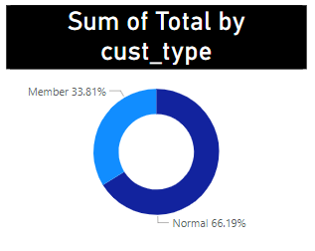
Task 7
Best Product Line by Customer Type (6 Marks)
Walmart wants to know which product lines are preferred by different customer types
(Member vs. Normal).
SQL Query
WITH cust_and_productline_counts AS
(SELECT `Customer type` AS cust_type, `Product line` AS productline, COUNT(*) AS Total FROM walmartsales
GROUP BY `Customer type`, `Product line`),
ranked_product_lines AS
(SELECT cust_type, productline, Total,
RANK() OVER (PARTITION BY cust_type ORDER BY Total DESC) AS Ranks
FROM cust_and_productline_counts)
SELECT cust_type, productline, Total
FROM ranked_product_lines
WHERE Ranks = 1
ORDER BY cust_type;

Slide 15
Task 8
Identifying Repeat Customers
Walmart needs to identify customers who made repeat purchases within a specific time frame
(e.g., within 30 days).

Slide 16
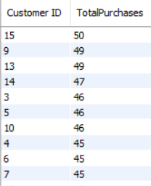
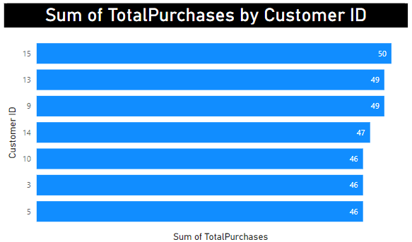
SQL Query
WITH customer_purchases AS
(SELECT `Customer ID`,`Date`,
ROW_NUMBER() OVER (PARTITION BY `Customer ID` ORDER BY `Date`) AS purchase_sequence FROM walmartsales),
purchase_intervals AS
( SELECT c1.`Customer ID`,c1.`Date` AS purchase_date,c2.`Date` AS next_purchase_date, DATEDIFF(c2.`Date`, c1.`Date`) AS days_between_purchases
FROM customer_purchases c1
INNER JOIN customer_purchases c2 ON c1.`Customer ID` = c2.`Customer ID` AND c1.purchase_sequence + 1 = c2.purchase_sequence),
all_cust_data AS
(SELECT `Customer ID`, purchase_date, next_purchase_date, days_between_purchases
FROM purchase_intervals
WHERE days_between_purchases <= 30
ORDER BY days_between_purchases DESC)
SELECT `Customer ID`, COUNT(*) AS TotalPurchases
FROM purchase_intervals
WHERE days_between_purchases > 0
GROUP BY `Customer ID`
ORDER BY COUNT(*) DESC;

Slide 17
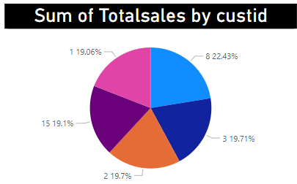
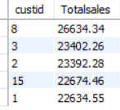
Task 9
Finding Top 5 Customers by Sales Volume
Walmart wants to reward its top 5 customers who have generated the most sales Revenue
SQL Query
SELECT `Customer ID` AS custid, ROUND(SUM(Total),2) AS Totalsales
FROM walmartsales
GROUP BY `Customer ID`
ORDER BY Totalsales DESCLIMIT 5;

Slide 18
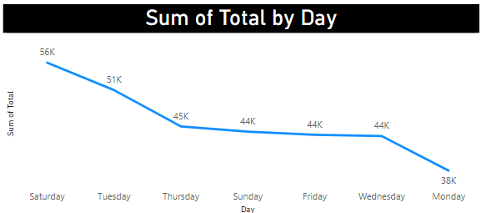
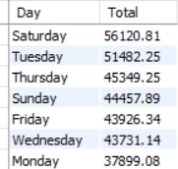
Task 10
Analyzing Sales Trends by Day of the Week
Walmart wants to analyze the sales patterns to determine which day of the week brings the
highest sales.
SQL Query
SELECT DAYNAME(Date) as Day, ROUND(SUM(Total),2) AS Total
FROM walmartsales
GROUP BY DAYNAME(Date)
ORDER BY Total DESC;

Slide 19

Key Findings

Slide 20

KEY FINDINGS
Branch A has the highest sales growth rate of 3.32%.
Branch A's most profitable product line is Home and Lifestyle with ₹20,282.22.
Branch B's most profitable product line is Sports and Travel with ₹18,084.56.
Branch C's most profitable product line is Food and Beverages with ₹21,503.34.
Most customers are classified under the Medium spending category, with Customer ID 8 as the highest spender at ₹26,634.34.
Food and Beverages shows a high anomaly in sales with ₹56,144.84, and Health and Beauty shows a low anomaly with ₹49,193.74.
Yangon prefers E-wallet (126 transactions), Naypyitaw prefers Cash (124 transactions), and Mandalay prefers E-wallet (113 transactions).
Female customers spent more than male customers in January and February; however, male spending overtook in March.
Members prefer Food and Beverages, while Normal customers prefer Electronic and Fashion Accessories.
Customer ID 8 has the highest sales volume of ₹26,634.34, while Saturday shows the highest sales by day.

Slide 21
THANK YOU

